Slide 1
Lecture 6
Recap
Advanced Quantum Algorithms
Quantum Fourier Transform
Quantum Phase Estimation
Q&A, Short break
Quantum Enhanced Fast Linear Algebra
Hamiltonian Simulation

Slide 2
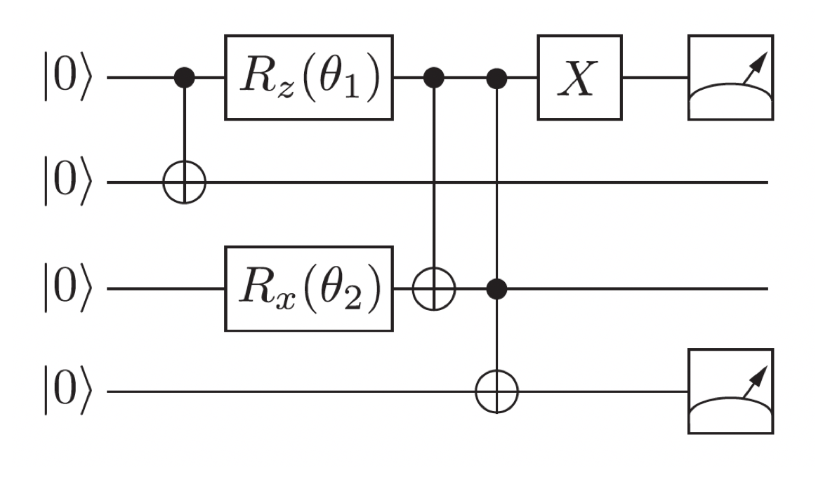
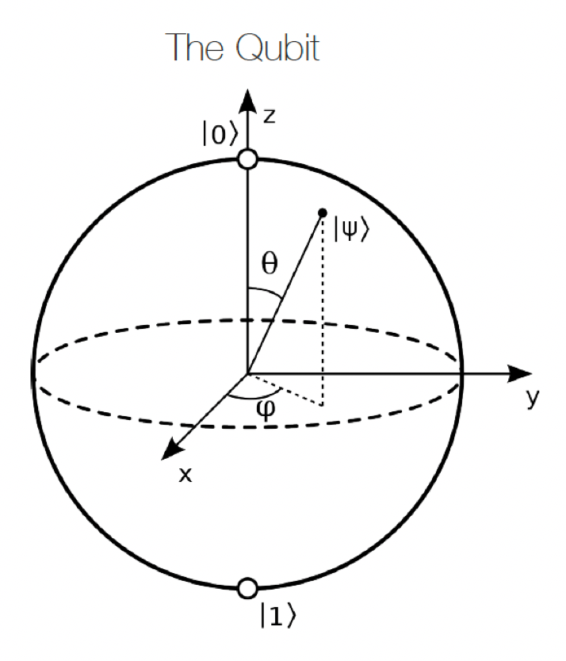
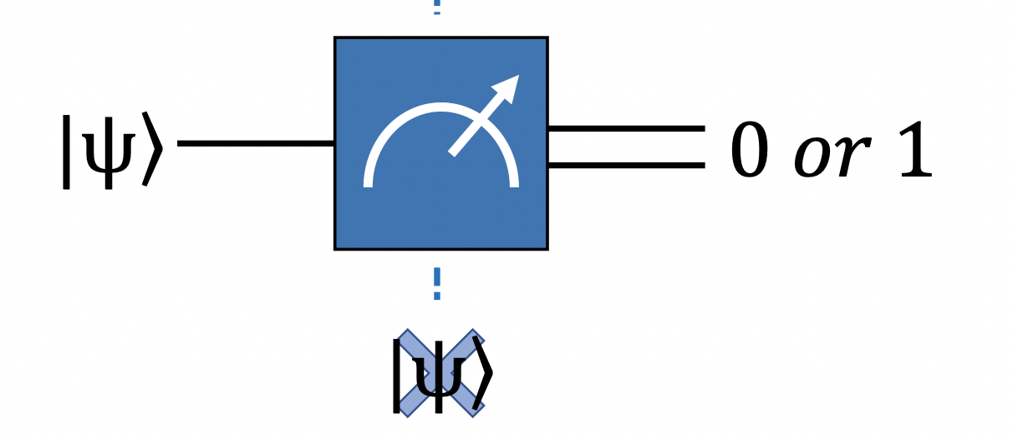
Recap: What have we done so far?
Basic building blocks for quantum computation

Slide 3
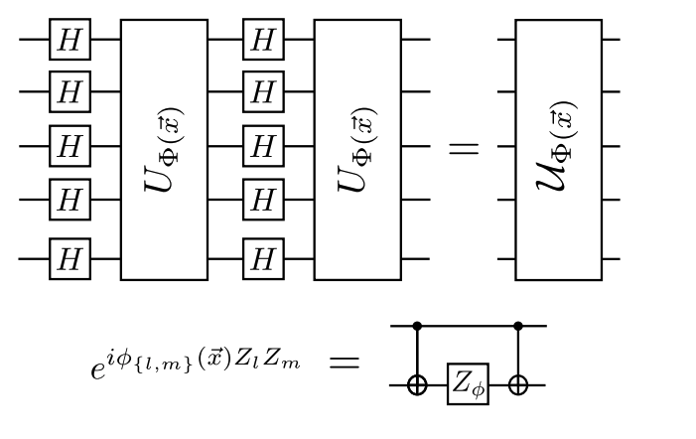
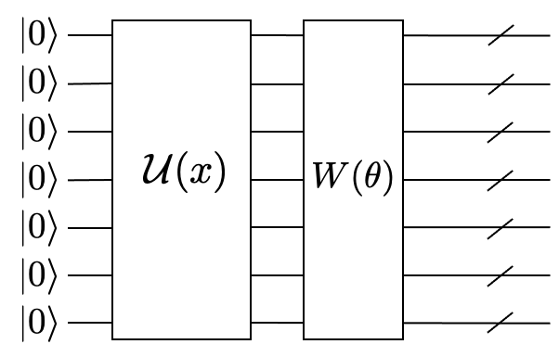
Recap: What have we done so far?
Heuristic and variational QML methods: QSVM, QNN

Slide 4
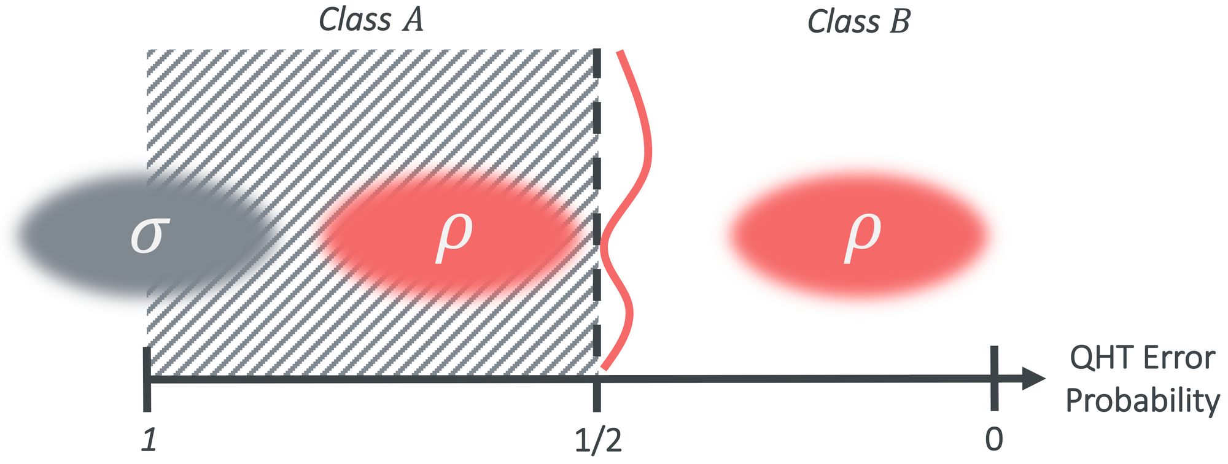
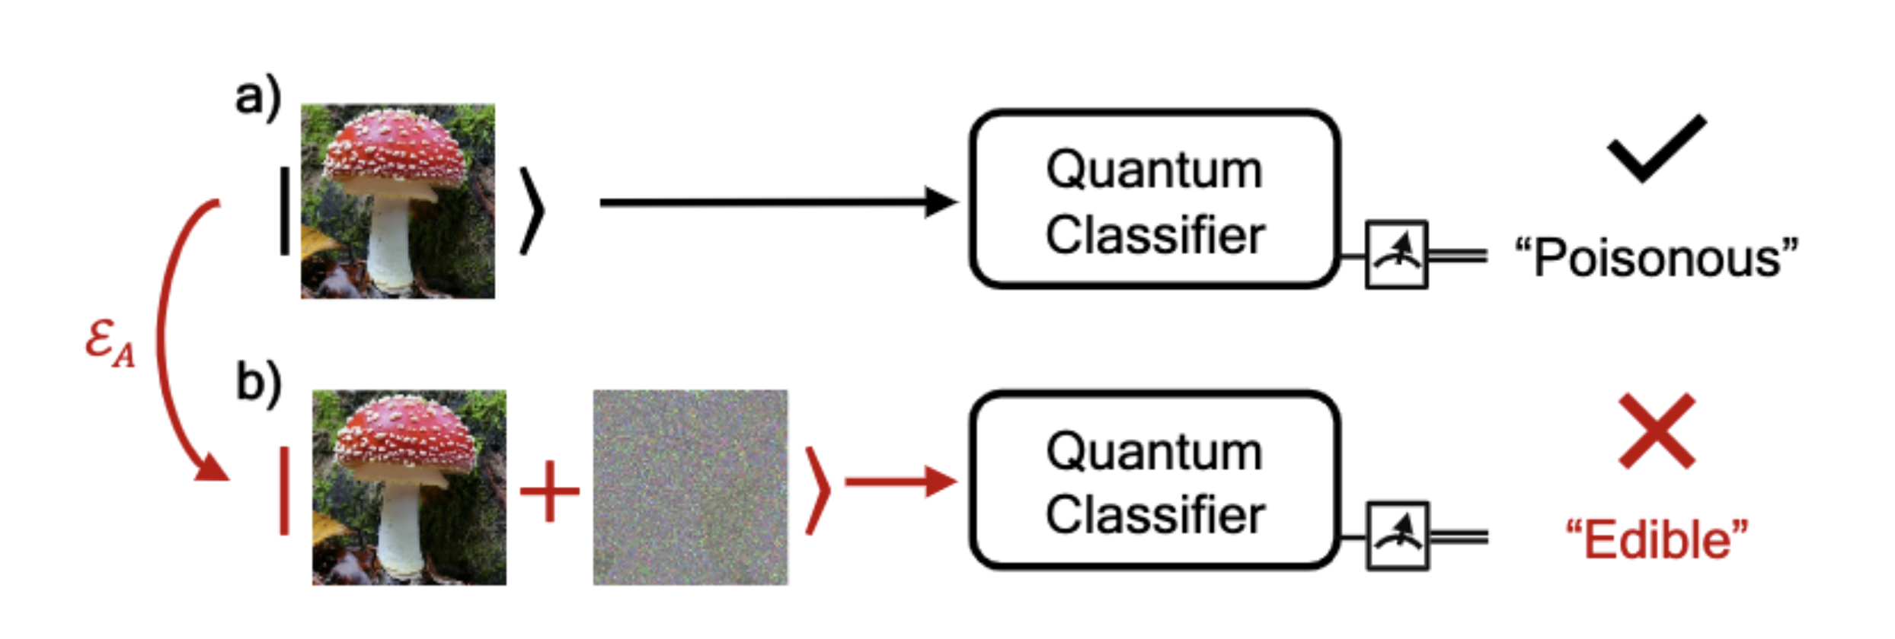
Recap: What have we done so far?
Error, noise, adversarial robustness and confidence intervals

Slide 5
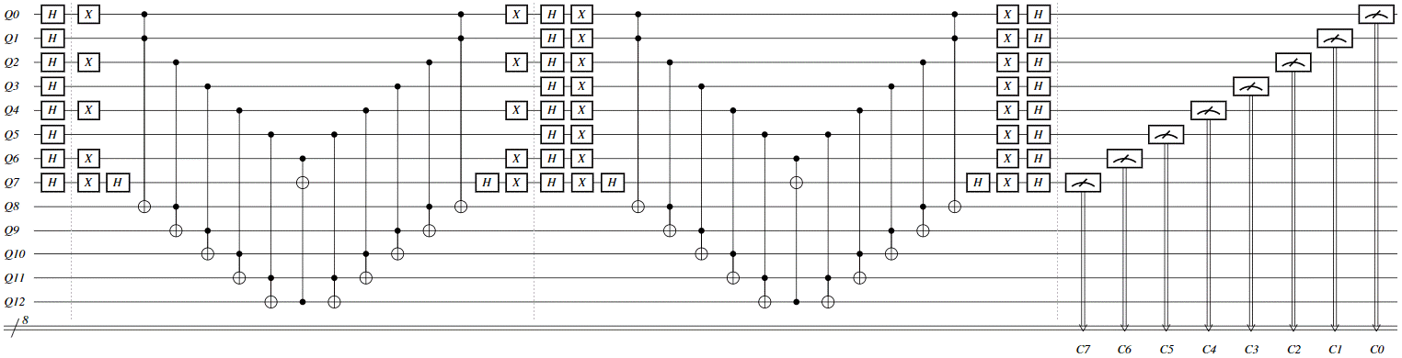
Advanced Quantum Algorithms
Advanced quantum computing methods are typically more “hardware demanding” .

Slide 6
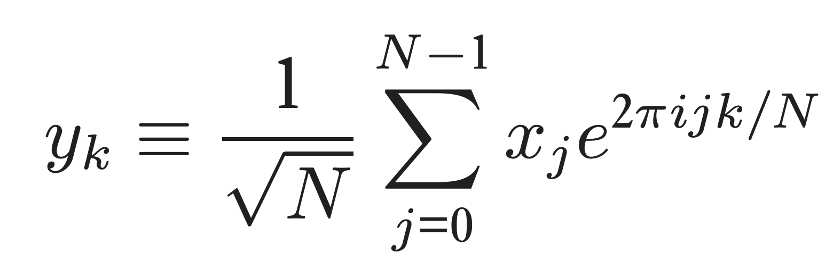
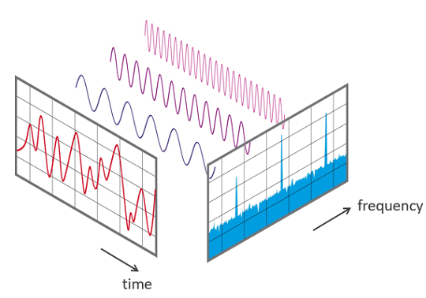
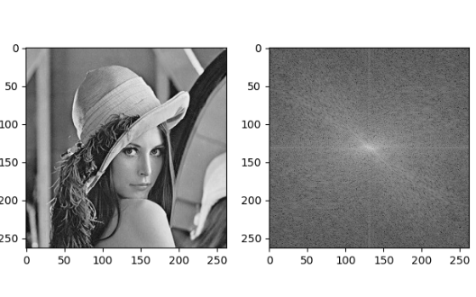
Quantum Fourier Transform
Normalised Discrete Fourier transform of
with entries

Slide 7
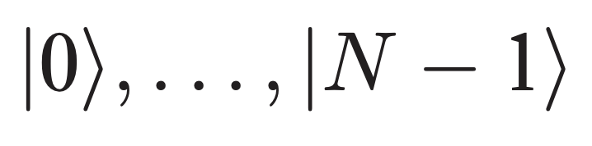
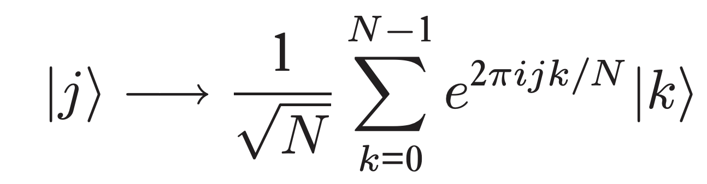
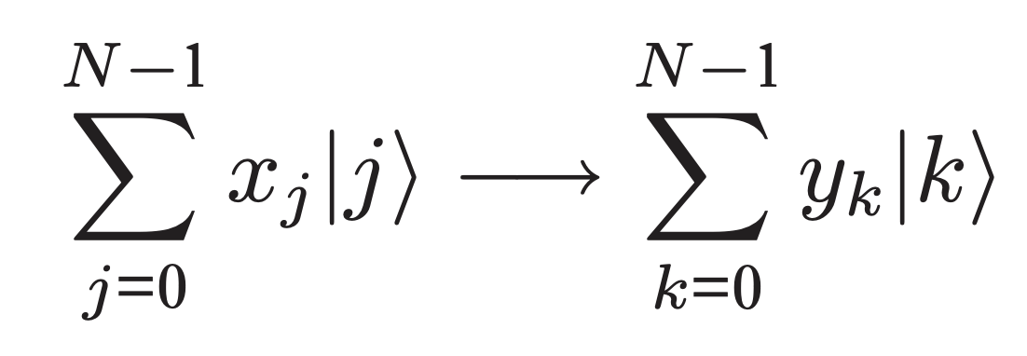
Quantum Fourier Transform
on basis states
on arbitrary states
with

Slide 8
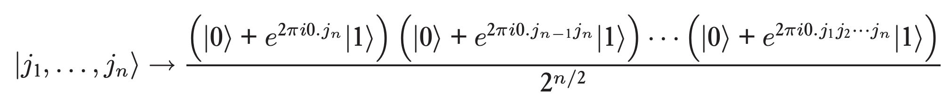
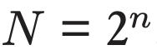
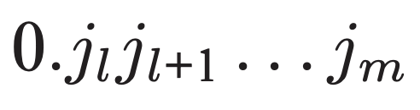
Quantum Fourier Transform
Product representation
Number of qubits = n ;
Binary fraction notation:
in binary representation

Slide 9
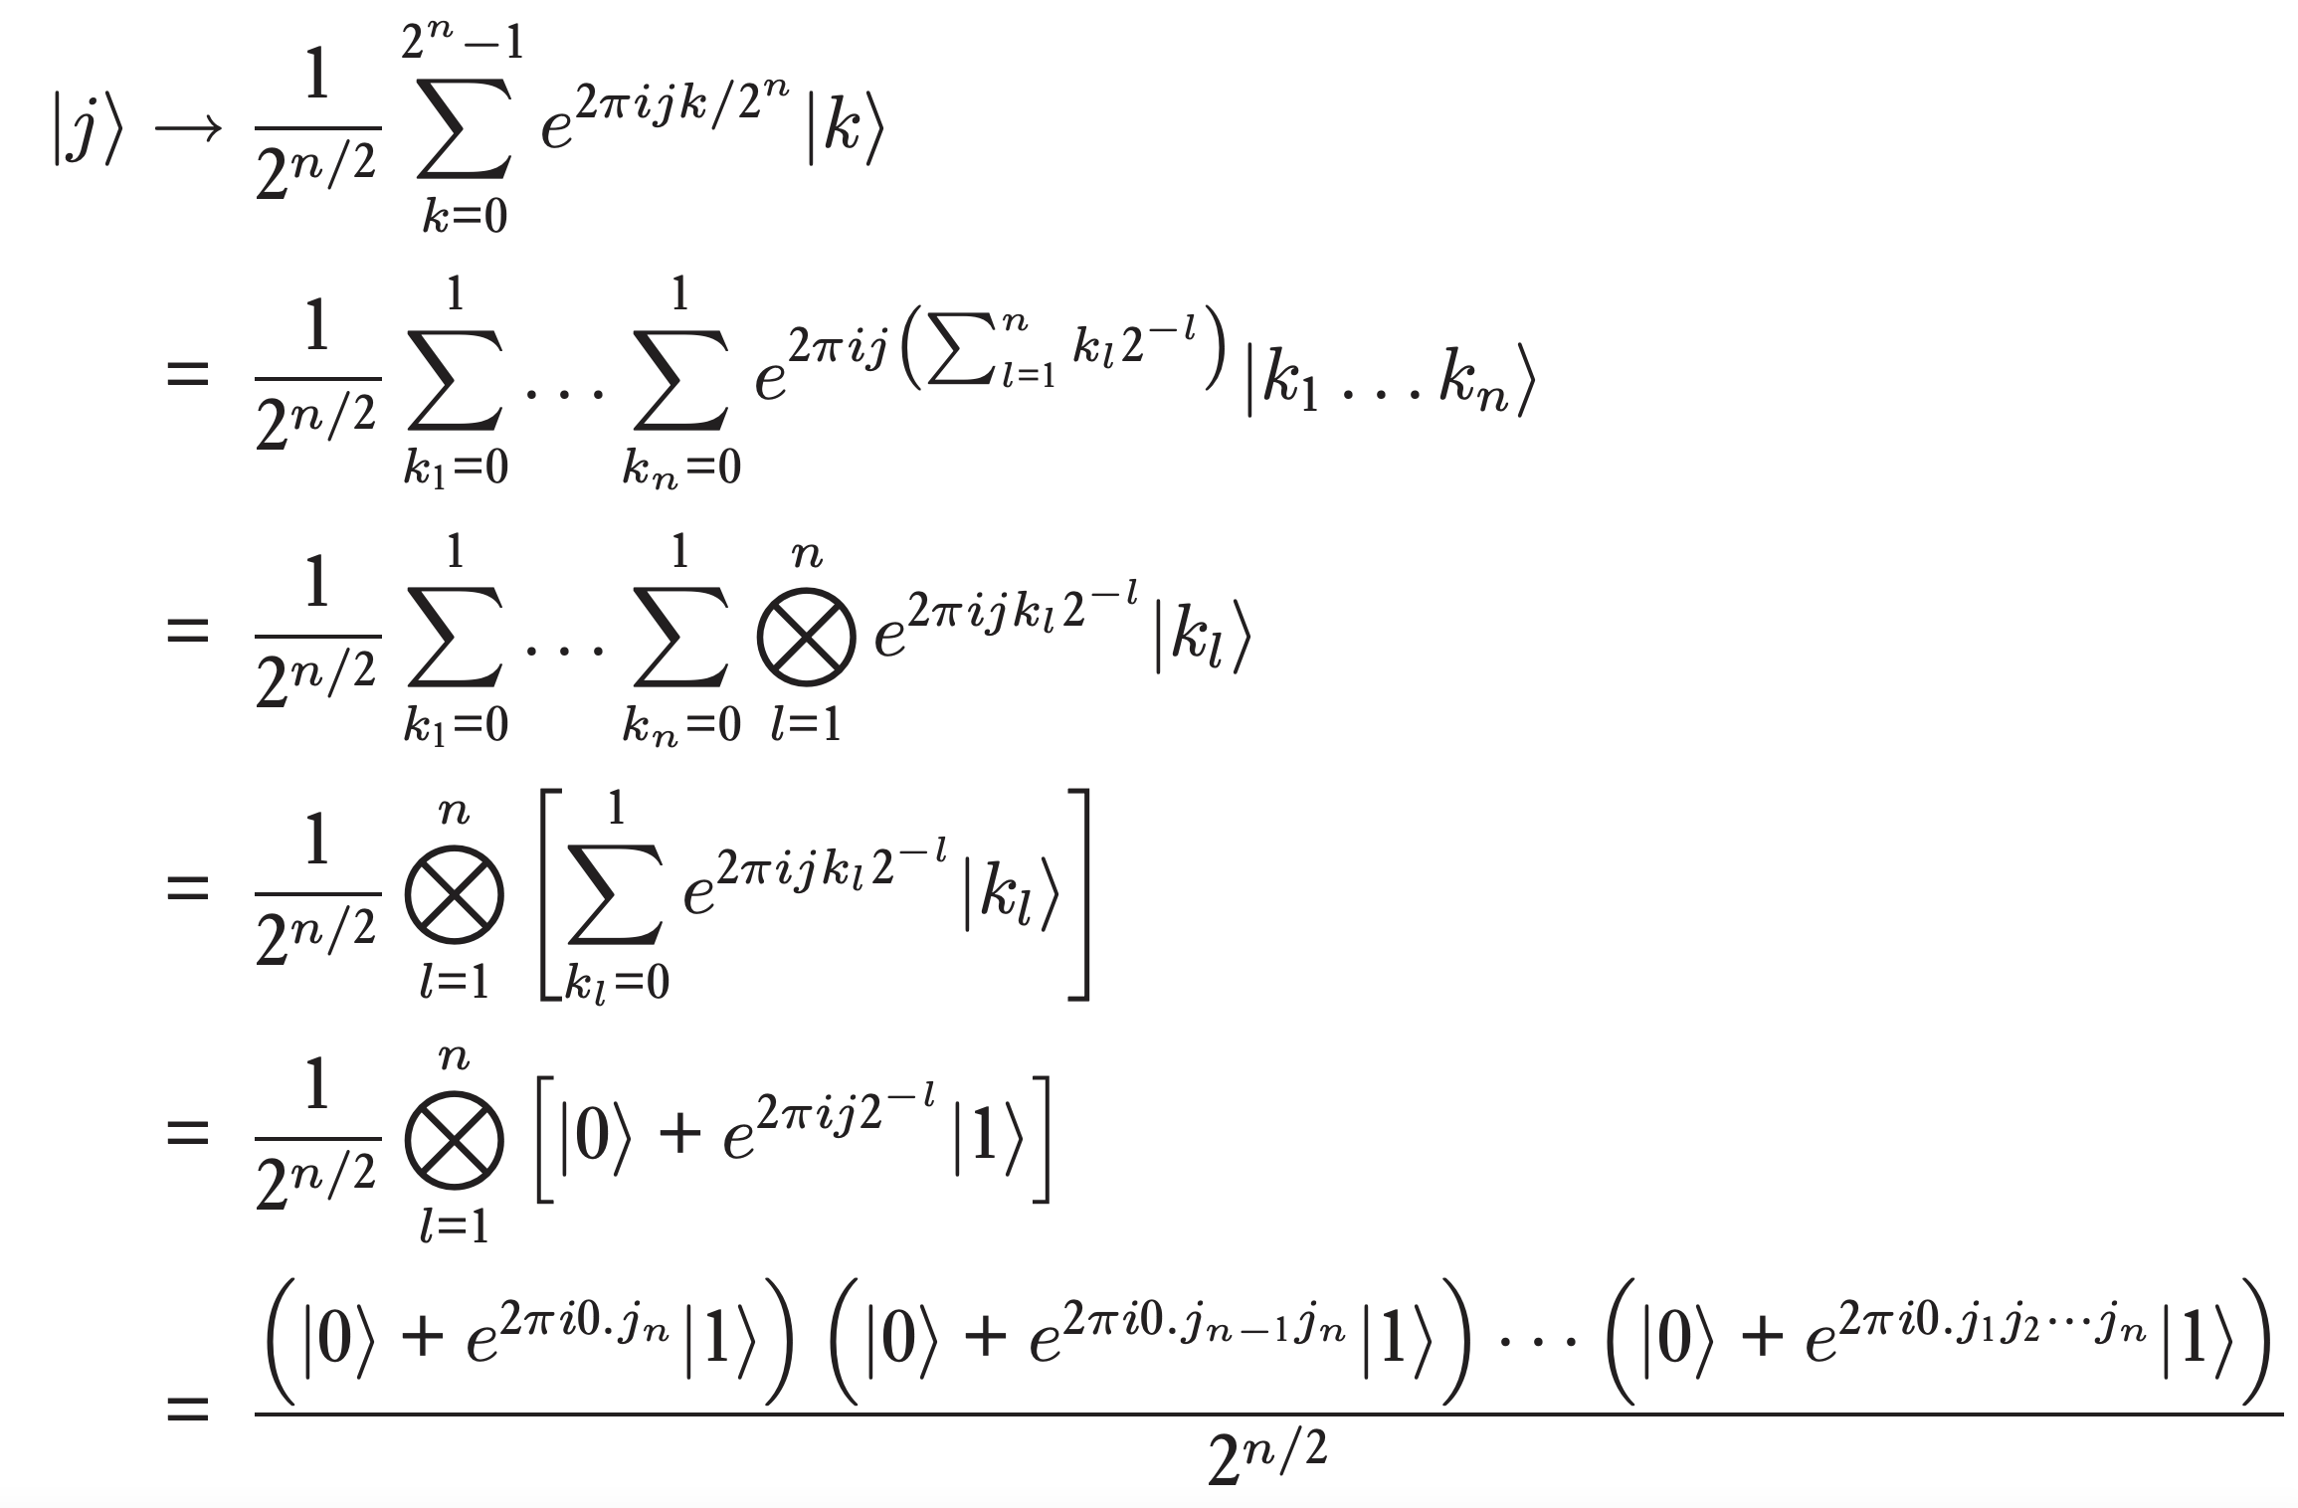
Proof --
Product representation

Slide 10
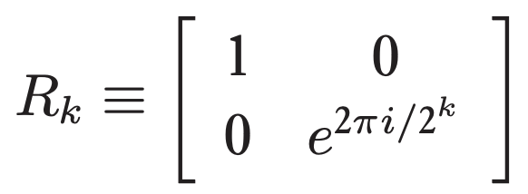
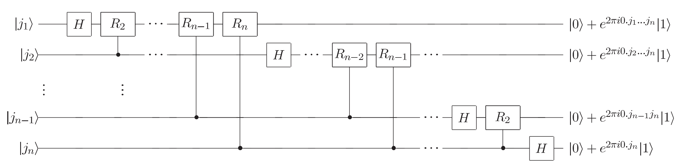
Q.F.T – Quantum circuit
with

Slide 11
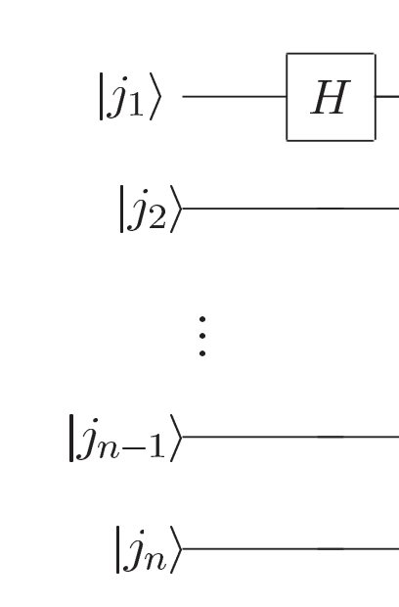
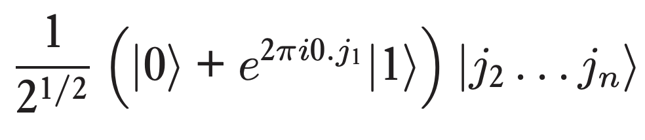
Q.F.T – Quantum circuit

Slide 12
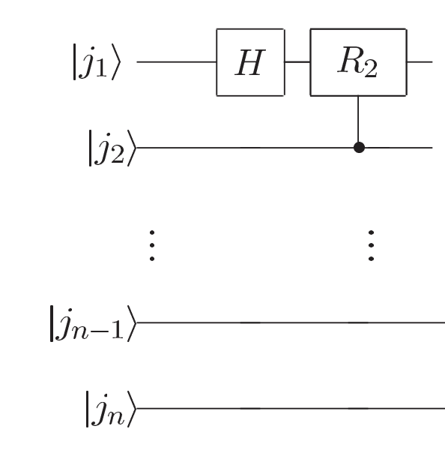
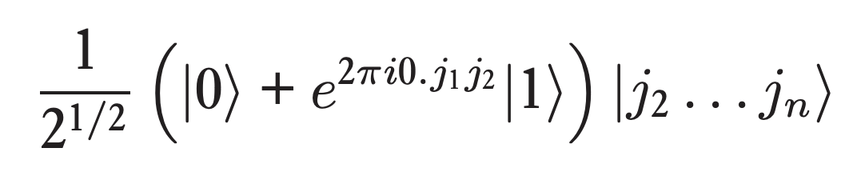
Q.F.T – Quantum circuit

Slide 13
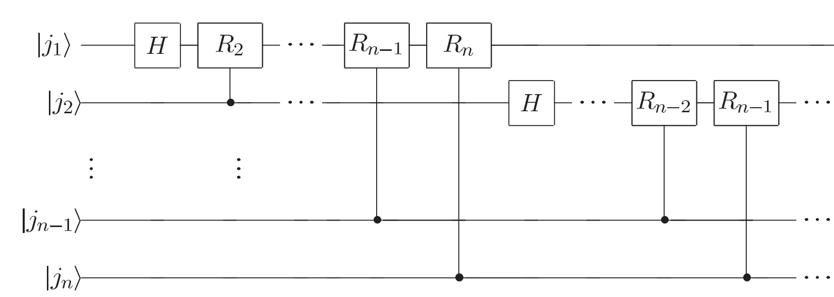
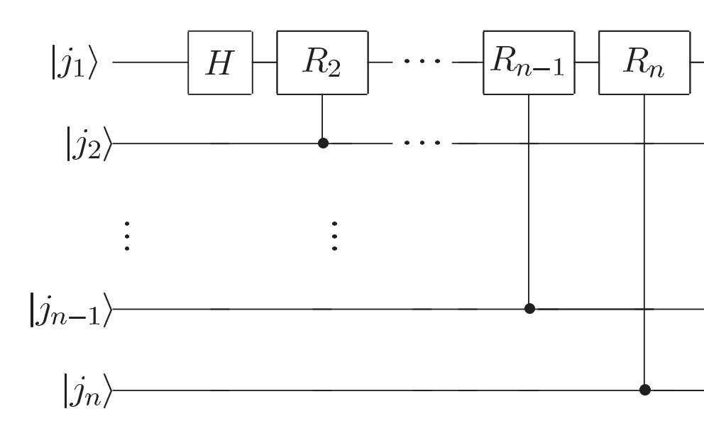
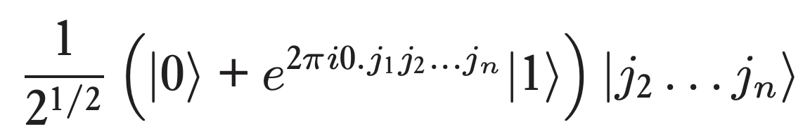
Q.F.T. – Quantum circuit

Slide 14
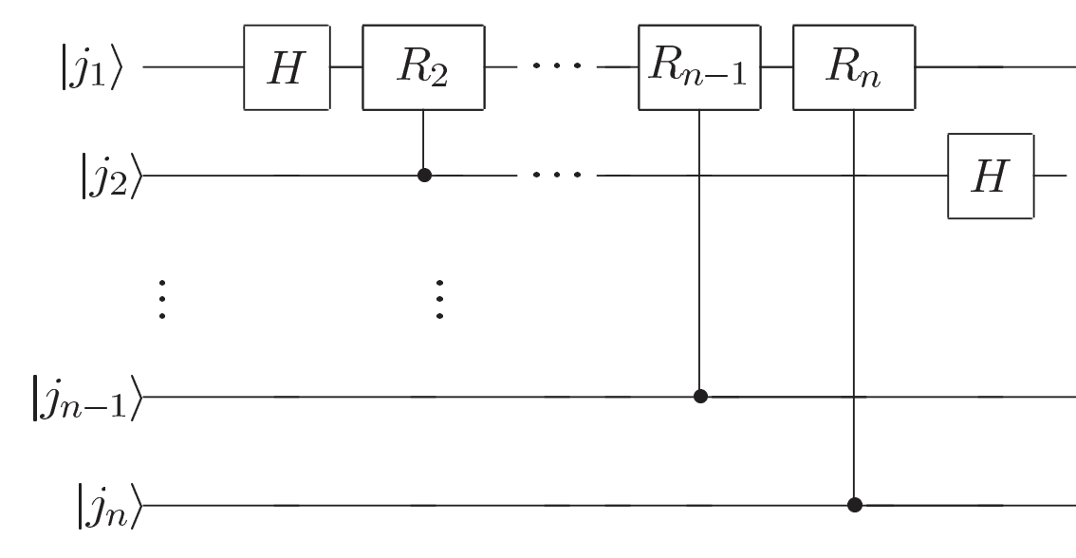
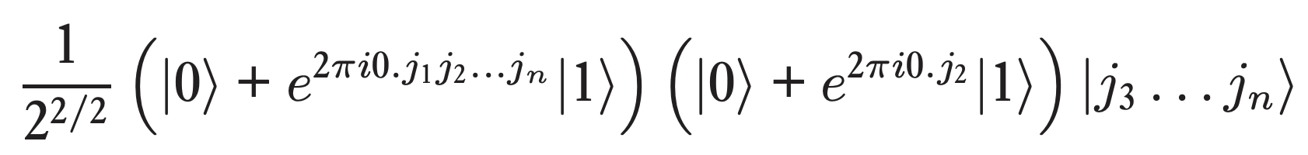
Q.F.T. – Quantum circuit

Slide 15
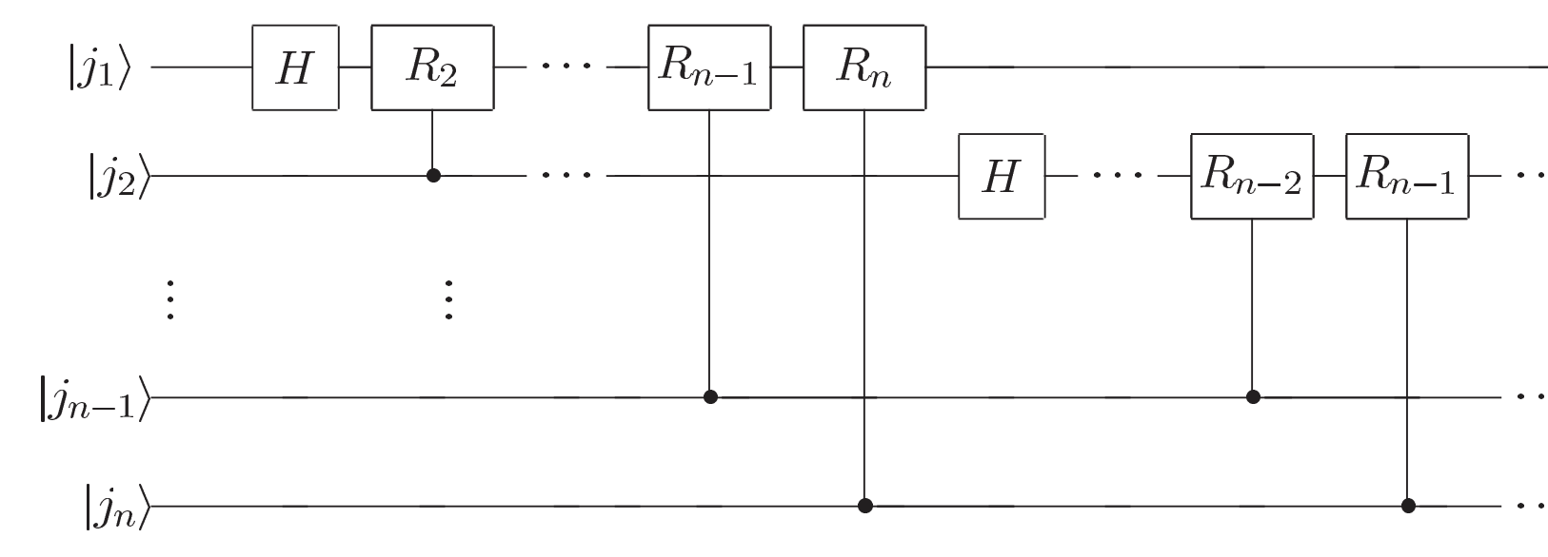
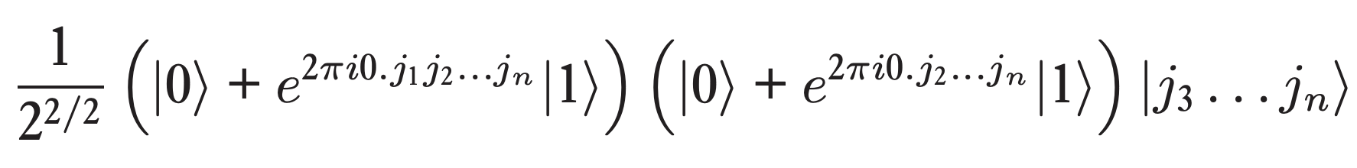
Q.F.T. – Quantum circuit

Slide 16
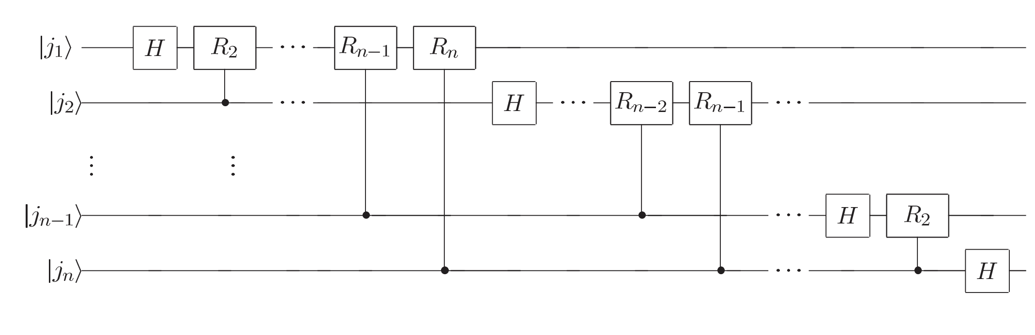
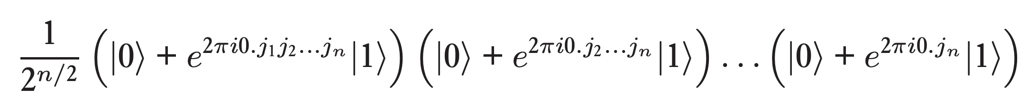
Q.F.T. – Quantum circuit

Slide 17
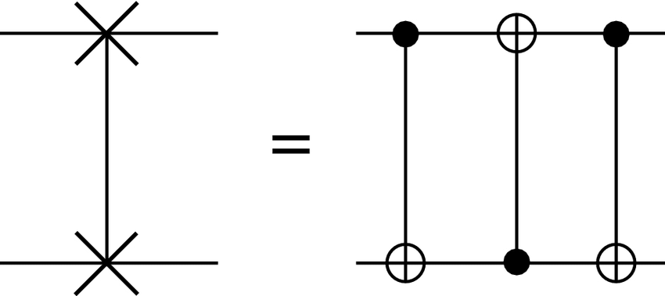
Q.F.T. – Something wrong with
?
SWAP

Slide 18
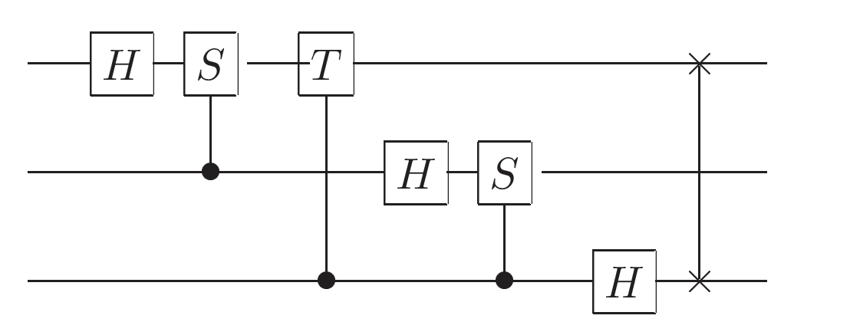
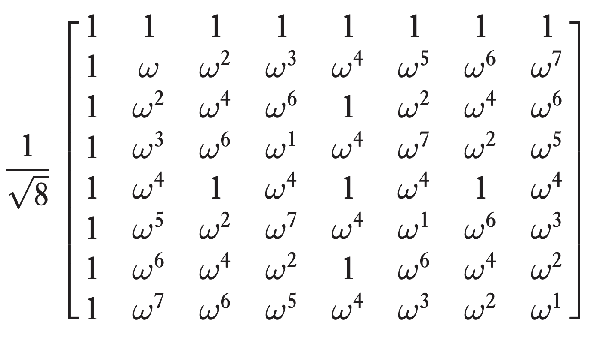
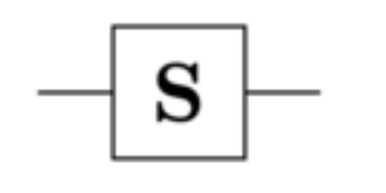
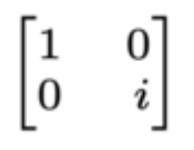
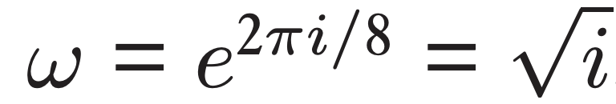
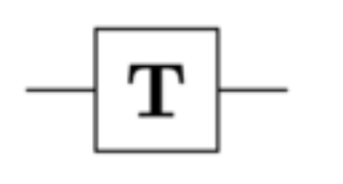
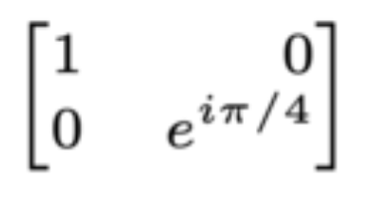
Q.F.T. – 3-qubit example

Slide 19
Quantum Fourier Transform
Complexity: Given access to a set of basic unitary gates and n qubits, a quantum computer can perform the discrete Fourier transform on 2^n amplitudes with only O(n^2 ) Hadamard and controlled phase gates.
Compare to classical FFT O(n2^n)
Applications: Phase estimation, fast factoring (Shor’s), fast linear algebra and more.

Slide 20

Questions & Intermission

Slide 21
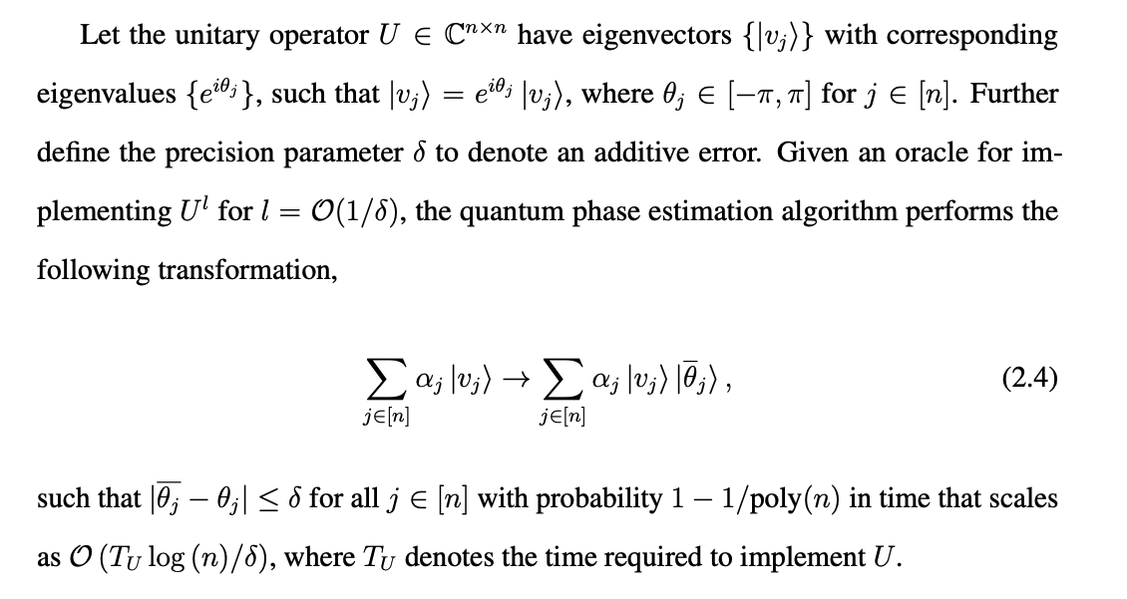
Quantum Phase Estimation

Slide 22
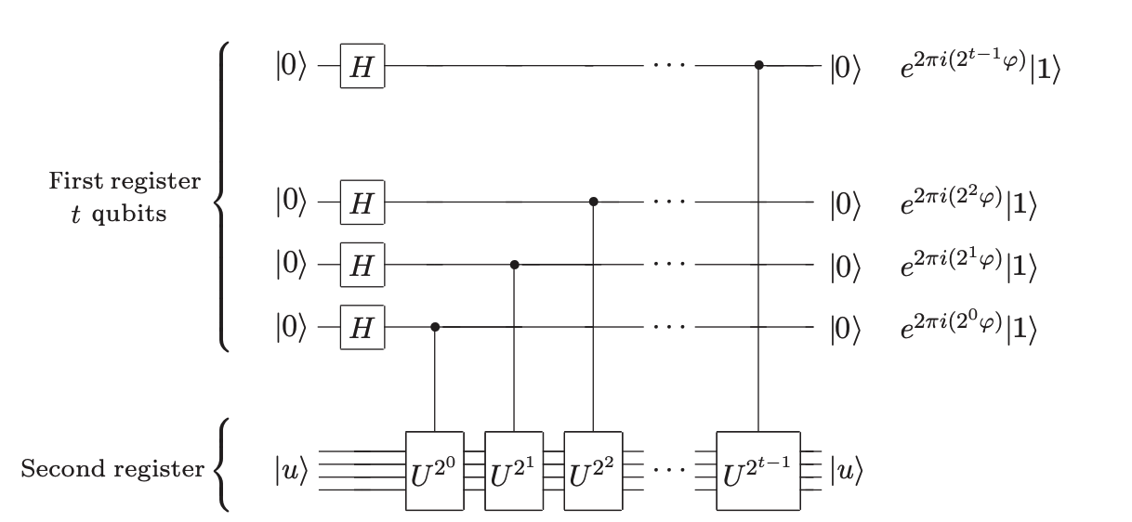
Quantum Phase Estimation – Oracle based controlled rotation step

Slide 23
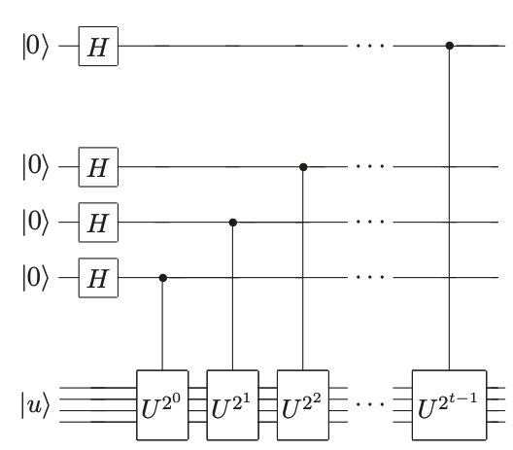
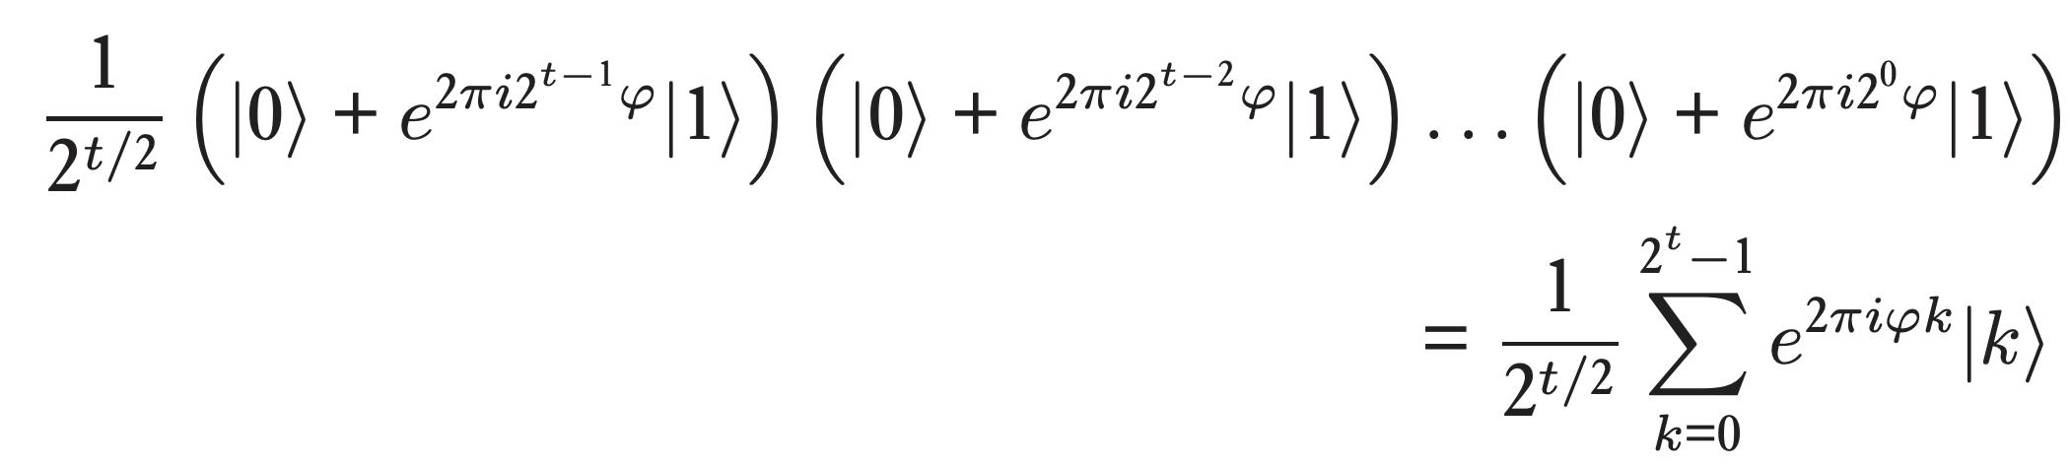
Quantum Phase Estimation – Oracle based controlled rotation step
This looks familiar?

Slide 24
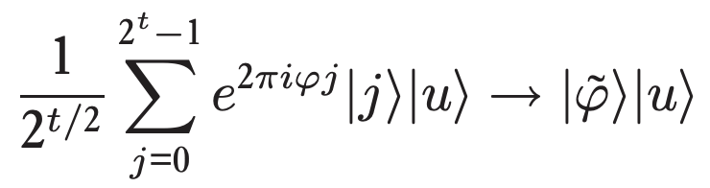
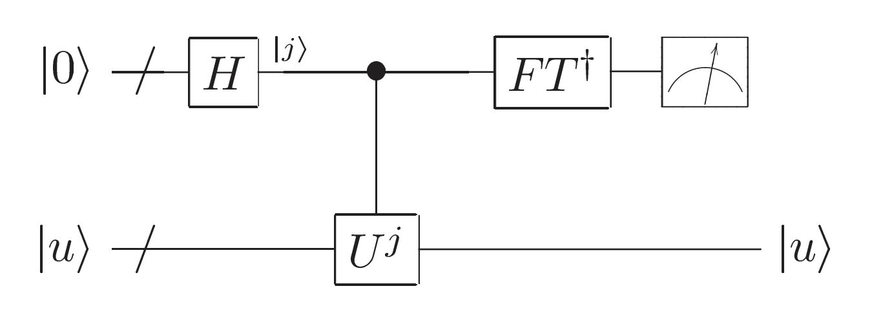
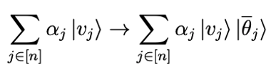
Quantum Phase Estimation – inverse QFT for completion
First register
Second register

Slide 25
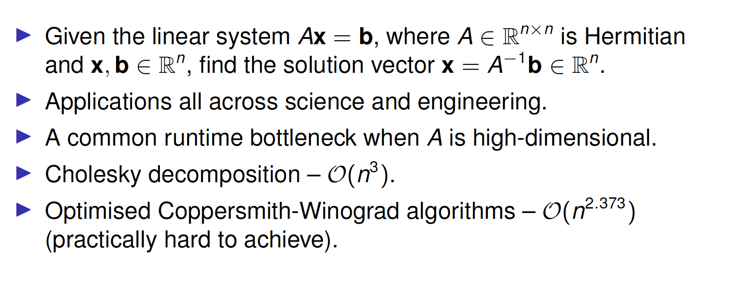
Quantum Linear System Algorithm

Slide 26
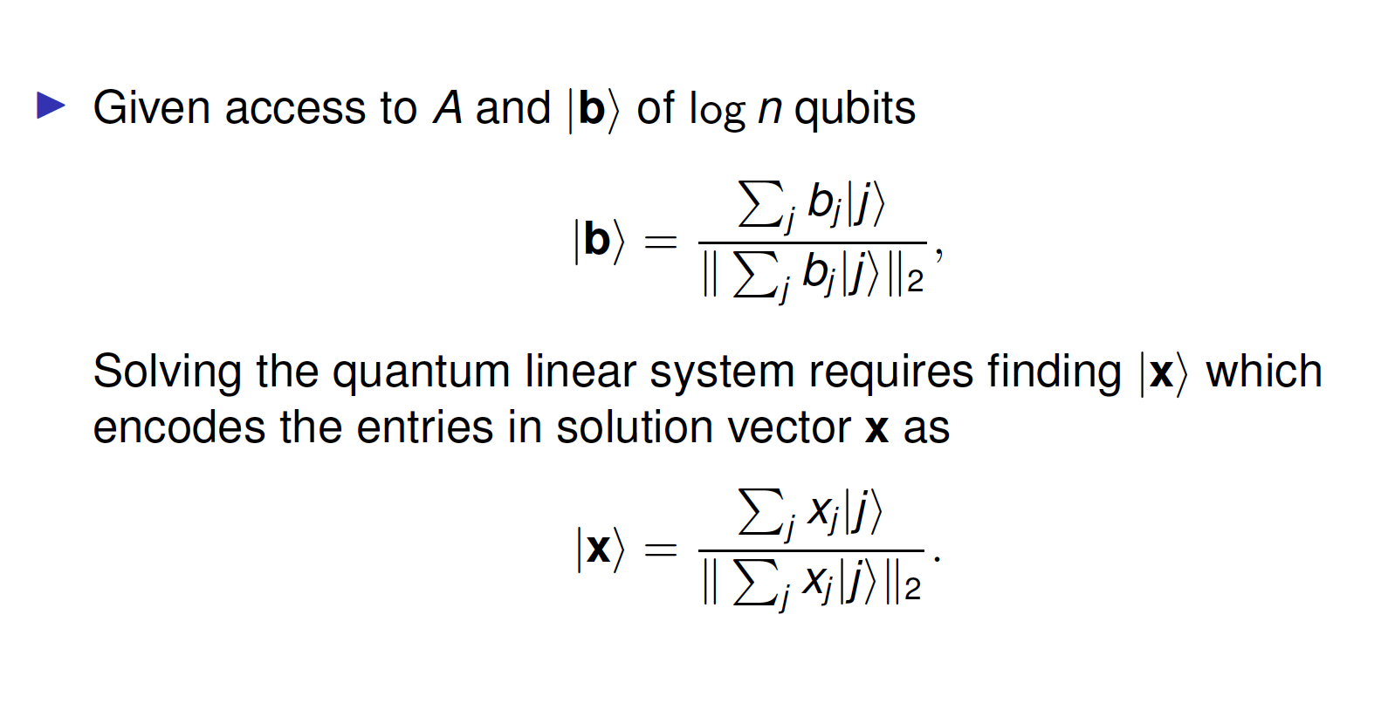
Quantum Linear System Algorithm

Slide 27




Quantum Linear System Algorithm
Hamiltonian simulation (in a nutshell )
Give access to H, implement the solution of
That is, implement

Slide 28

Quantum Linear System Algorithm

Slide 29


Quantum Linear System Algorithm
We improved the efficiency of QLSA in the cases when the
A is dense in 2018

Slide 30


Generic quantum enhanced linear algebra subroutines

Slide 31

Generic quantum enhanced linear algebra subroutines

Slide 32

To be continued…
More on quantum enhanced linear algebra
Example ML application: Quantum-enhanced Gaussian processes

